Slide 1
Sequence
Notes:
Learning Objectives
- To understand how block coding works.
- To program a simple algorithm using block coding.
Resources
Template: j2e.com/code/template/Y1template3
Example: j2e.com/code/examples/visual/Y1example3
Video: just2easy.com/vids/j2code/Y1video3

Slide 2
Algorithm
Sequence
Sprite
Notes:
Introduce students to key vocabulary for this lesson:
Algorithm: An unambiguous procedure or precise step-by-step guide to solve a problem or achieve a particular objective.
Sequence: “When we sequence things, we arrange them in a particular order. Sequence-based algorithms are made from a precise set of instructions.”
Sprite: These are the images that perform actions in a Visual program. Examples are the Penguin, rocket etc. Note however, that the backgrounds are also sprites.

Slide 3
A sequence is when we arrange something in a particular order. Sequence-based algorithms are made from a precise set of instructions.
Notes:
Explain to students about the importance of sequence in computing/coding.
In sequence-based algorithms, such as a recipe to bake a cake, the order of many (though not all) of the steps is crucial. Similarly, most programming languages are based on a series of statements to sequentially process. The outcome of a program will depend not only on the constituent commands but their order.

Slide 4
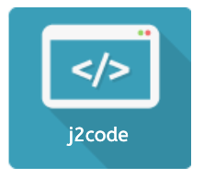
Notes:
Purpose
To introduce the use of sequence/block coding in j2code visual.
Learning objective
By the end of this tutorial children should be able to:
I can use logical reasoning to explain how some simple algorithms work.
To know that an algorithm is a set of instructions.
To create simple algorithms to make a rocket move.

Slide 5
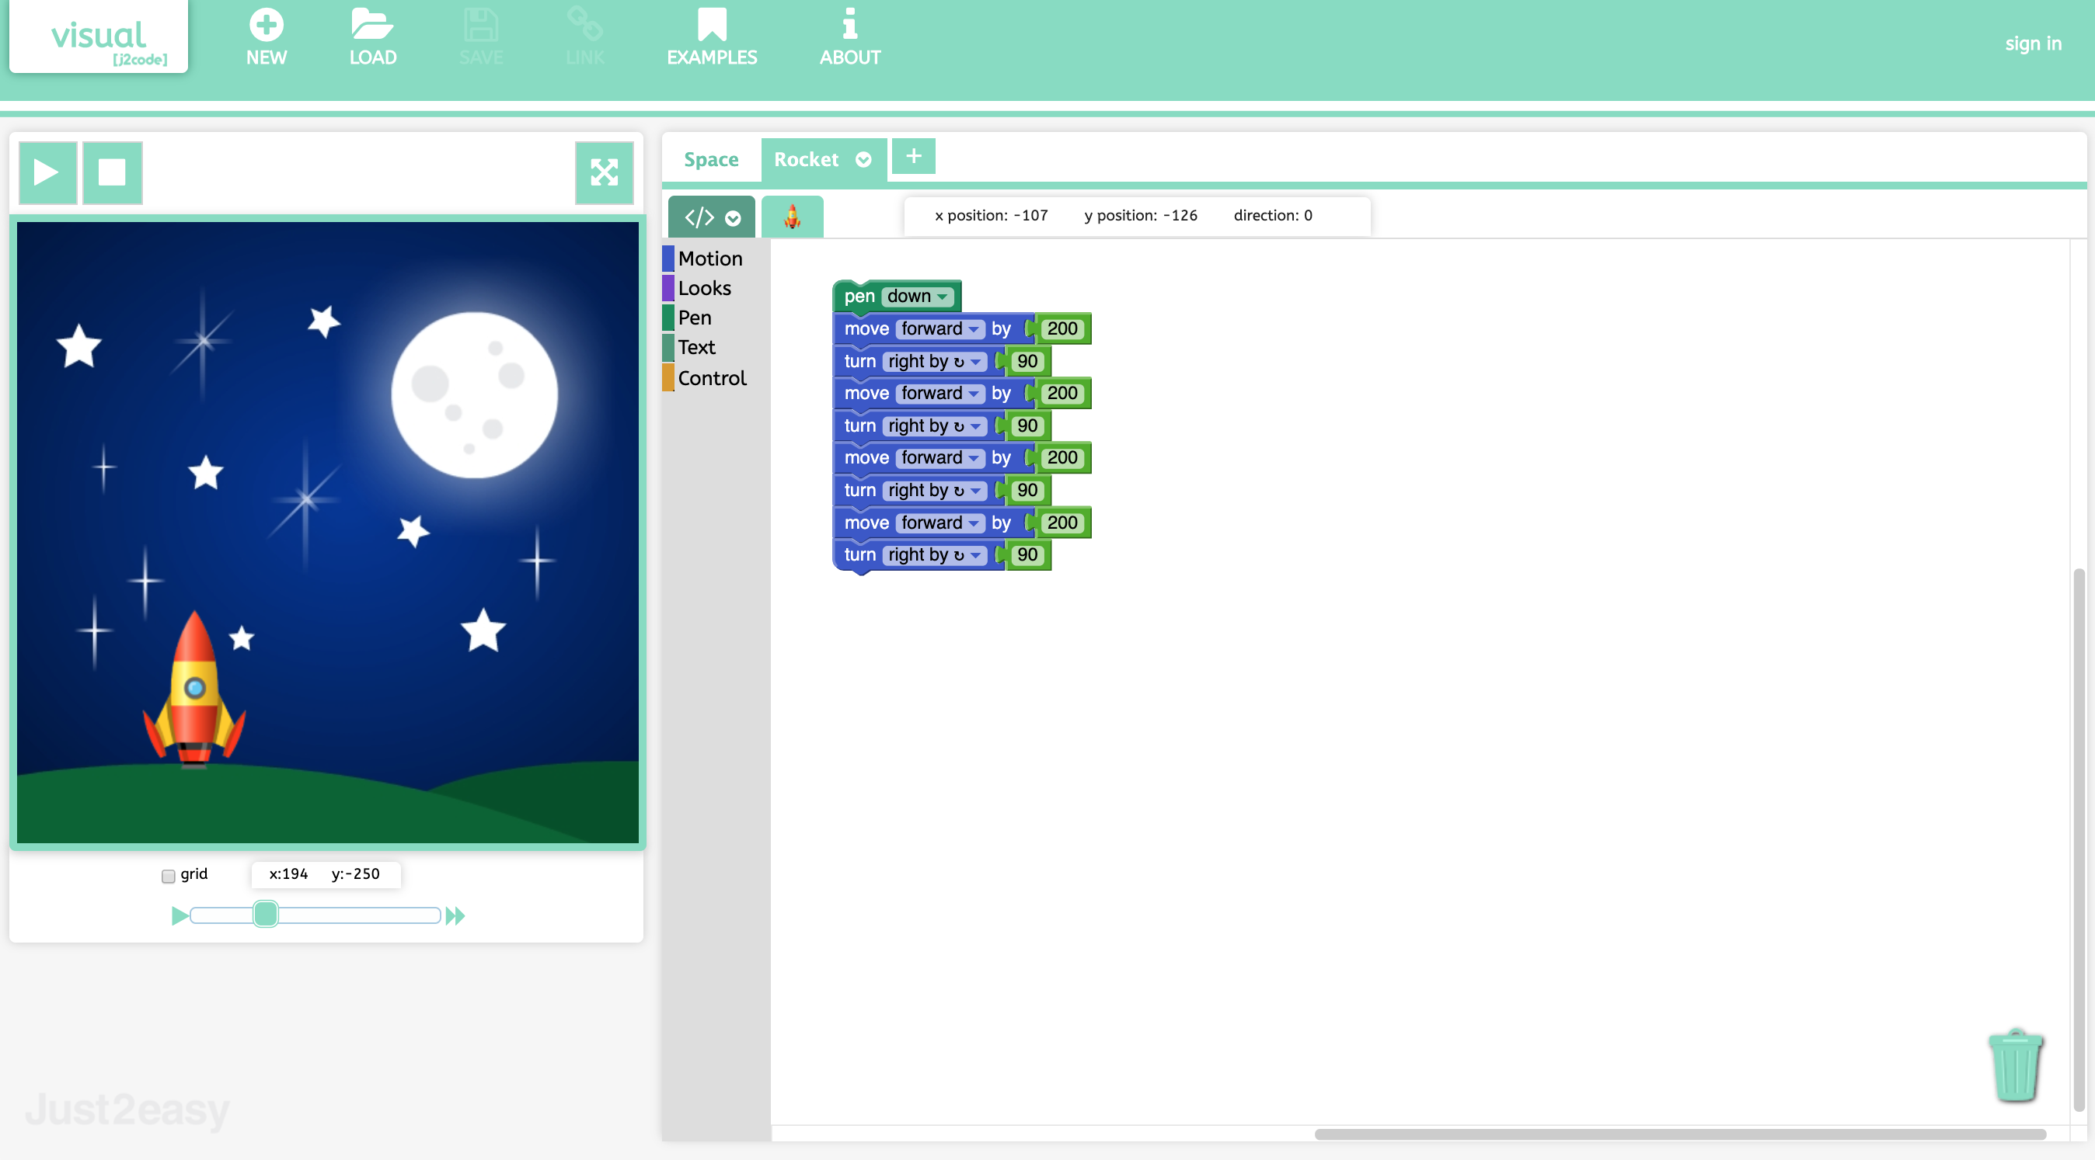
Notes:
Introduction
Discuss the wording on each block. Show children how to change the wording (use the dropdown) and change the numbers (by highlighting and over-typing). Introduce the word motion blocks and show the children how to drag these from the block menu onto the code area.

Slide 6
Notes:
Main Activities
Load template 3.
Task 1- children experiment with making the rocket move around using the move and turn blocks. Can they make a square?
Stop the class to discuss any problems.
Task 2- move the rocket to the moon and back to its start position. Let the children experiment to do this in different ways.
Stop the class and show children how to create a new background and a rocket sprite and how to rename and resize them
Let the children experiment with doing this independently.

Slide 7
Notes:
Explore and challenge
Ask students to make a simple animation relating to their topic for example ‘weather’.
https://www.j2e.com/london-grid-for-learning/bdardis/Weather/
Allow for students to explore this over an additional session.

